Slide 1

JAN
MSCI Coverage Consultation
2015
Adapting to a Changing world
Launched: October 2014
Concluded: January 2015
Background
Due to Shanghai and Hong Kong listing standards – three years profitability required before going public – many of today’s Chinese internet companies choose to list on U.S. exchanges at the time of their IPOs. This has resulted in a gap in coverage in the MSCI Global Investable Market Indexes (GIMI) that has become too big too ignore. With household names such as Baidu already missing from MSCI’s brand name indexes, the $200 billion straw that broke the camel’s back came in the form of Alibaba’s record IPO in September of 2014. Trading only as an ADR listed in the U.S., it quickly became apparent to investors that Alibaba, too, would be getting the snub from MSCI. Recognizing this new market nuance, MSCI issued a proposal to enhance the coverage methodology of their global indexes. As Beta would soon learn, what seemed on the surface an innocuous and welcome change was wrought with implications few may have considered.
Former Methodology
Companies which are not listed or do not have a liquid listing in their country of classification are ineligible for inclusion in the MSCI Global Investable Market Indexes.
Proposal
Companies Classified in Emerging Markets with listings in any time-zone would become eligible for the country, regional and global indexes. Companies classified in Developed Markets with listings solely in the same time-zone would become eligible for the country, regional and global indexes.
Considerations
From an investment perspective
Could the inconsistency in treatment for EM and DM securities result in unintended consequences down the road?
This change mainly impacts three countries: China (US listed), Russia (UK listed), and Hong Kong (Singapore listed). Given the current geopolitical risk in Russia, are we comfortable taking on increased exposure to Russia and/or experiencing turnover in our Russian country funds?
From an operational perspective
We are a global firm. Can we overcome the operational complications of having U.S. traded securities in Asia-Pacific country indexes? Specifically, what are the implications for our Asian registered iShares range?
Company | Sector | Weight in MSCI China
Alibaba | Info Tech | 7.10%
Baidu | Info Tech | 6.47%
JD.com | Consumer Disc | 2.07%
Ctrip Com | Consumer Disc | 0.81%
Netease | Info Tech | 0.76%

Slide 2
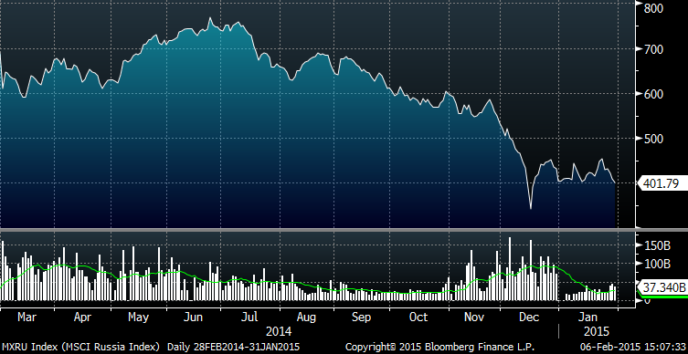
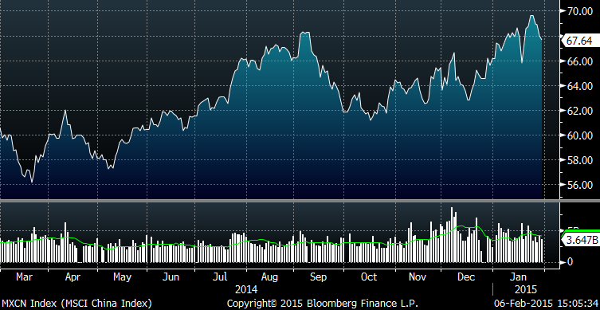
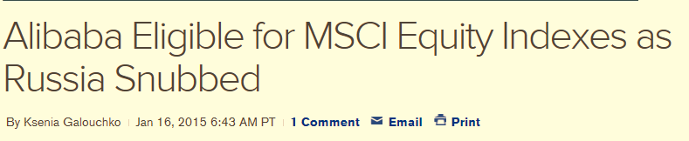
What to do with Russia?
Leading in a challenging global market
What to do with Russia?
The implications of this methodology change with respect to Russia was our primary concern. Implementing the change as proposed would result in all beta portfolios holding Russia taking seven new positions in Russian companies listed on foreign exchanges in order to track their MSCI benchmarks. With the ruble tumbling along with the price of oil and US/EU economic sanctions still in place, talk of capital constraints and the nationalization of Russian companies has perforated the markets. Given the uncertainty, we decided the risk of increased exposure to Russia in our index funds was not in the best interests of our clients at this time. Beta discussed this concern with MSCI, along with the others outlined above, and collaborated to reach the best outcome for all parties.
MSCI Russia: 2/28/2014 – 1/31/2015
Solutions
Materiality Threshold
Foreign listed companies would only be eligible in countries for which they represent 5% or more of the market cap and 0.05% of MSCI ACWI IMI.
Patience with Russia
MSCI agreed to defer the potential inclusion of additional foreign listed companies in the MSCI Russia Indexes until further notice.
Best Possible Outcome for our Clients
MSCI will make these changes to their index methodology effective with the November 2015 index review. MSCI indexes will now be a better reflection of a growing and changing global investment opportunity set. Before, opinion was that the MSCI China Index didn’t properly reflect China’s burgeoning technology industry, and instead was overweight state owned energy corporations and financial institutions. The new methodology results in an index representative of the transformation of China’s economy. At the same time, BlackRock Beta was able to work with MSCI to arrive at a solution that provided investors with this enhancement while at the same time protecting them from the current uncertainty in Russia. This highlights Beta’s investment leadership and collaboration with our business partners to deliver superior client experience.
MSCI China: 2/28/2014 – 1/31/2015
*2/28/14: Russia invades Crimea
*3/6/14: US and EU impose economic sanctions on Russia

